Slide 1

First Day!
Instructor: Carter Klebuc
Please Sign In!

Slide 2
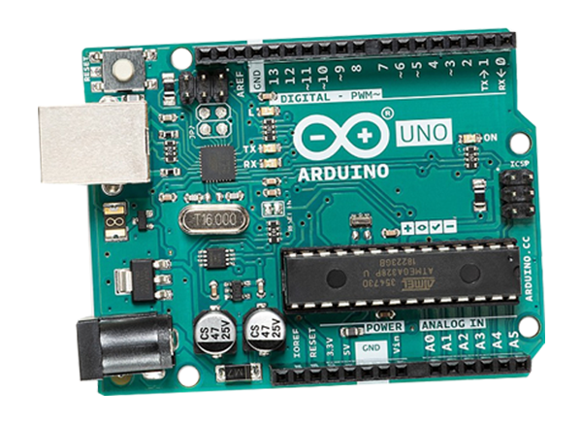
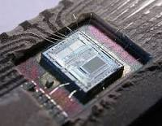
M is for Microcontroller
It is a small computer containing a processor, memory, and I/O (Input/Output) to interface with electronic parts (speakers, sensors) to achieve a certain goal.
Many electronic devices such as calculators and navigation systems are composed of microcontrollers

Slide 3
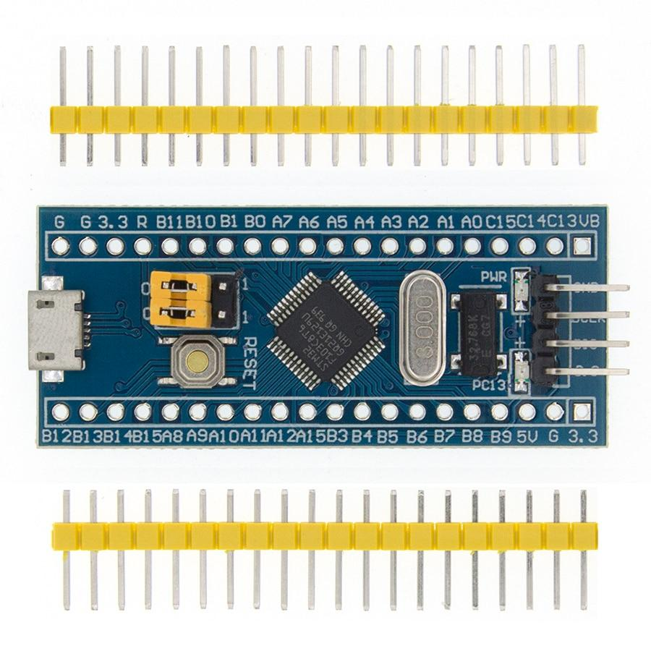
So what exactly is a STM32?
The STM32 is a family of microcontrollers developed by STMicroelectronics.
Its reliability, flexibility, and ease of use makes it widely used by many companies, hobbyists, and UH IEEE Members.
We are going to use the STM32 Blue Pill in our adventures

Slide 4
First Test!
Before we jump into the intricacies of developing our own music player, let's create a simple project to develop understanding of this device.
We are going to make a blinking LED circuit. While this sounds simplistic, it is recommended to finish easy projects before tackling more complex ones.

Slide 5
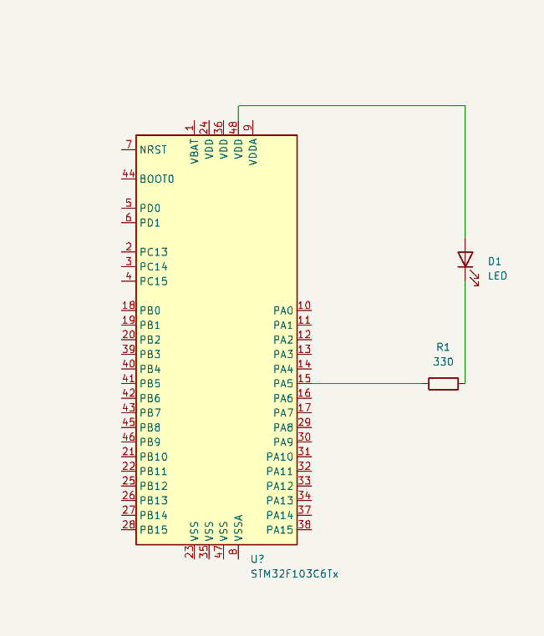
Plan it out
Work in electronics requires schematics to be made before actual circuitry is done.
This diagram will tell us where to connect the resistor and LED in the circuit

Slide 6
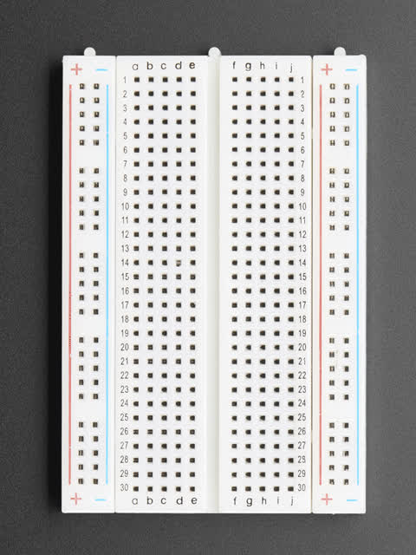
Let’s build this
We are going to use a breadboard to build this circuit. A breadboard is a plastic board with metal connections that engineers use to prototype circuits.
Breadboards use a coordinate system to specify which hole an electronic component should be put into

Slide 7
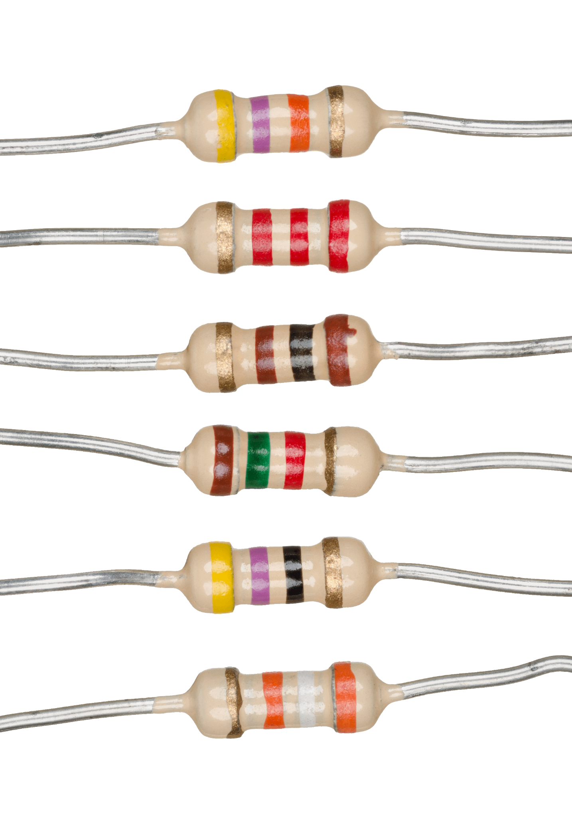
Resisting with Resistors
Resistors are electrical components that reduce electrical voltage and current in a circuit
Please insert one end of the resistor into A10 and the other end into A14

Slide 8
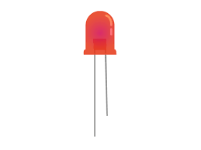
Light up with LEDs
LED’s are electronic components that emit light when current passes through them
Electric current passes through the shorter, negative, leg of the LED (the anode) to the longer, positive, leg (the cathode.
Insert the shorter leg of the led into B14 and the longer leg into B16
(-) Anode
(+) Cathode

Slide 9
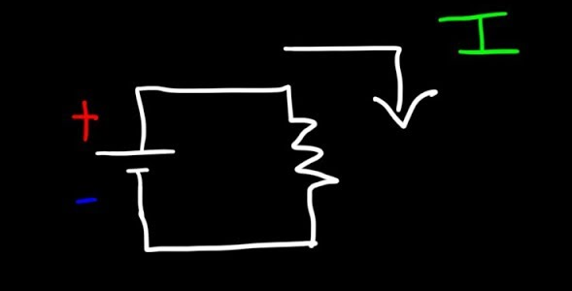
Power Time!
A circuit is connected to a ground and a power source to close the circuit. We will close the circuit by placing a wire in the same row as the cathode and by the 3.3 V pin
Please place one end of the wire into C16 and the other end into the same row as the 3.3 V pin

Slide 10
Set it up!
The STM32CubeIDE is a program we will use to configure and program the STM32 Microcontroller.
Please open the STM32CubeIDE and make a new project.
In the box that says “commercial part number”, type STM32F103C6T6A and click on the box with the same name
Type your cougarnet ID and HelloWorld for the project name

Slide 11
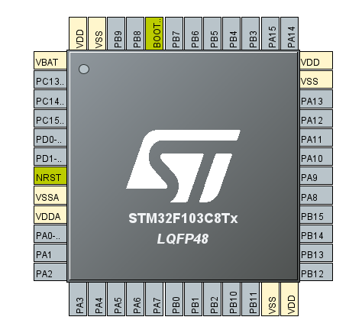
WHAT IS THIS!!!
The STM32 Microcontroller allows the user to customize what each of its pins does.
For now, let’s click on PA1 and click on GPIO_OUTPUT

Slide 12
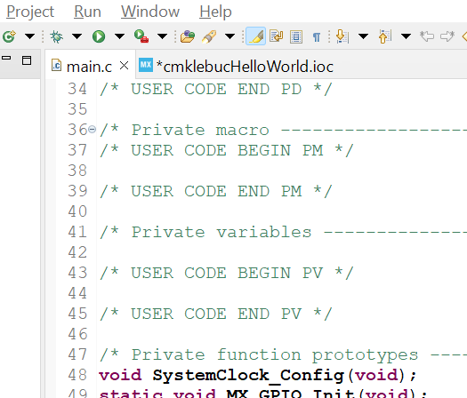
C is for Cool (& the programming language)
C is a programming language widely used in microcontrollers. We will be using the C language.
Please click on main.c in the window

Slide 13
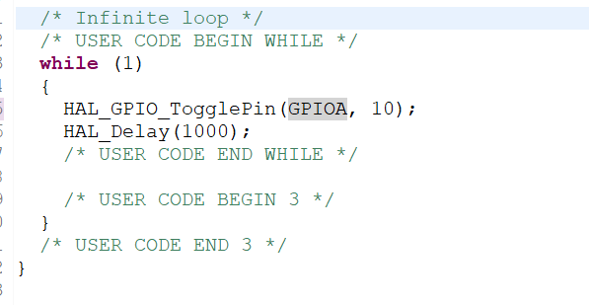
Programming the STM32 is weird for the instructor too
On main.c, scroll down until you see while(1). When you find it, write HAL_GPIO_TogglePin(GPIOA,); on one line and HAL_Delay(1000); on the next.
We will fill in the blank space in the TogglePin function.
Write GPIO_PIN_## where ## is the number of the pin connecting to the resistor (it’s labeled on the STM32)

Slide 14
THANKS FOR COMING!

